Slide 1



SESSION NAME HERE
Data Structures : Lists & Dictionaries

Slide 2


Data Science Lecture Housekeeping
The use of disrespectful language is prohibited in the questions, this is a supportive, learning environment for all - please engage accordingly. (FBV: Mutual Respect.)
No question is daft or silly - ask them!
There are Q&A sessions midway and at the end of the session, should you wish to ask any follow-up questions. Moderators are going to be answering questions as the session progresses as well.
If you have any questions outside of this lecture, or that are not answered during this lecture, please do submit these for upcoming Open Classes. You can submit these questions here: Open Class Questions

Slide 3
Data Science Lecture Housekeeping cont.
For all non-academic questions, please submit a query: www.hyperiondev.com/support
Report a safeguarding incident: www.hyperiondev.com/safeguardreporting
We would love your feedback on lectures: Feedback on Lectures

Slide 4


Learn about the most frequently used and versatile collection data type in Python - the List
Learn about another popular collection data type - Dictionaries
Learn how to manipulate lists and dictionaries.
Lecture Objectives

Slide 5

Lists
Lists are used when we need to store a lot of data, or the order in which the data is stored is important to us.
Lists are capable of holding many items in one place as well as keeping the data in order.
Python will also provide each piece of data an index that will represent its position in the list.

Slide 6
Lists
A List is a specialised format of storing and organising data.
A List is basically a group of items / data.
Lists are known as sequence data types because they behave like an ordered collection of items.

Slide 7
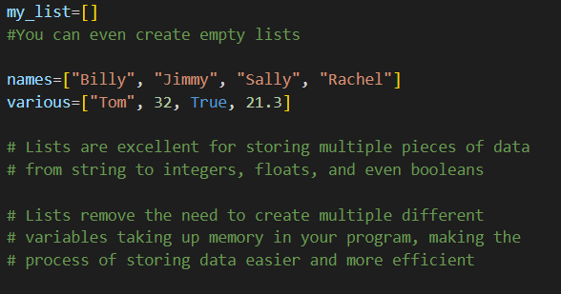
List Example & Syntax

Slide 8
Indexing Lists
Similar to strings, we are able to index and slice lists.
However, instead of indexing by character, we index lists by the entire value in that specific position.

Slide 9
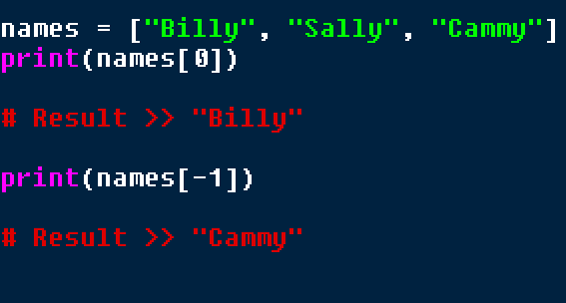
Indexing Example

Slide 10
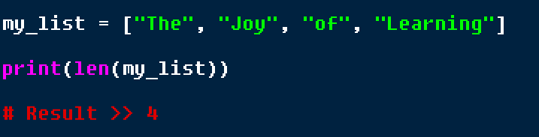
Finding the Length of a List
Similar to what we can do with strings, we can use the len() function to find the length of a list.
Example :

Slide 11
Accessing all values in a List
Sometimes we need to access all values / items in a list at the same time; to achieve this we can simply iterate through the list with a for loop.
This would be especially useful when we cannot exactly see all the data within a list and we must evaluate the data / make adjustments / add to the list / remove from the list.

Slide 12
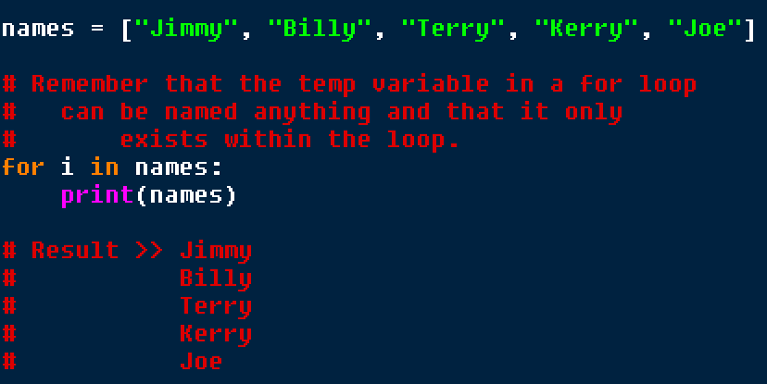
Looping through Lists Example

Slide 13
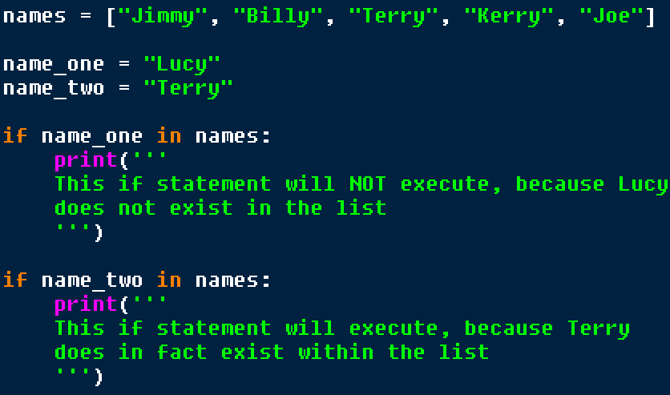
In Operator and Lists

Slide 14
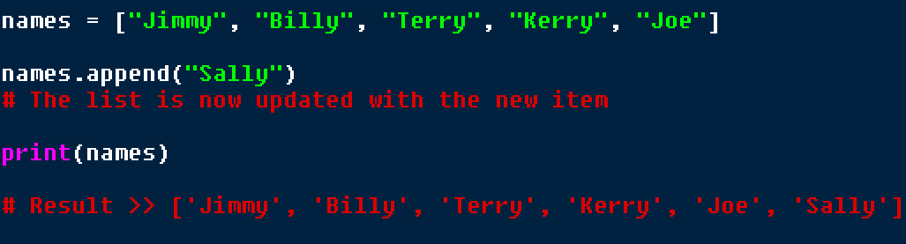
Appending data to Lists
We can add new items to a list by using the .append() method, keep in mind that append will only add to the end of a list, and nowhere else.
Example :

Slide 15
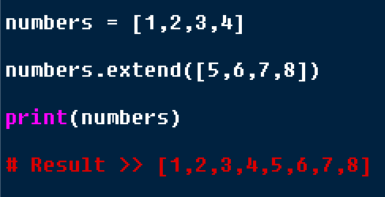
Extending Lists
We can extend lists with multiple values which will be attached at the end.
It is similar to append, but is capable of adding multiple values.

Slide 16
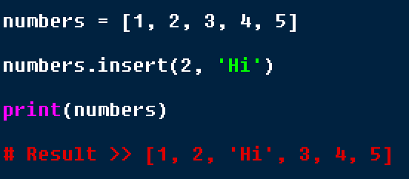
Inserting into List
We can insert values at a specific position in the list using indexing.
Takes two arguments, first is the index, followed by the element to add.

Slide 17
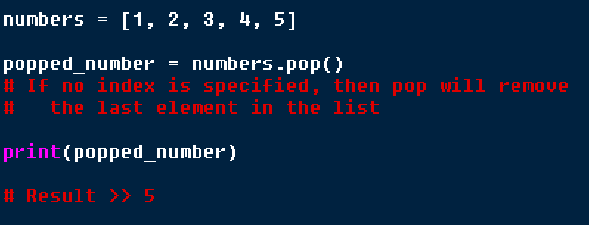
Popping from a List
The pop method will remove an element at an index, then return it.
Return meaning that the popped element can be stored and used in a variable.

Slide 18

Let’s Breathe
Let’s take a small break before moving on to the next topic.

Slide 19
Dictionaries
Python dictionaries are similar to a list, however each item has two parts, a key and a value.
For example, an English dictionary has the word (key) and then it’s definition (value).

Slide 20
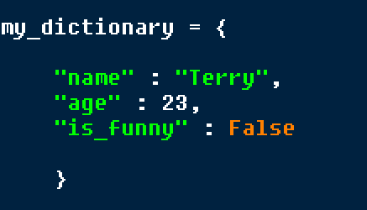
Dictionaries
Dictionaries are enclosed in curly brackets; key value pairs are separated by a colon and each pair is separated by a comma.
On the left is the key, on the right is the value.

Slide 21
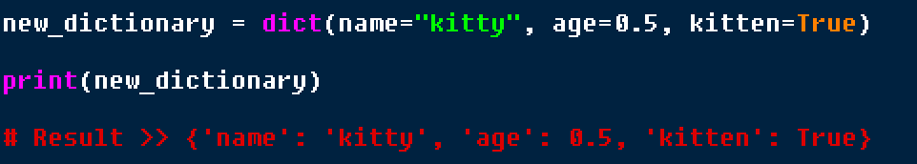
Dict Function
Used to create dictionaries.
Assign values to keys by passing in keys and values separated by and = sign.

Slide 22
Accessing values in dictionaries
To access a value in a dictionary, we simply call the key and Python will return the value paired with said key.
Similar to indexing, however we provide a key name instead of an index number.

Slide 23
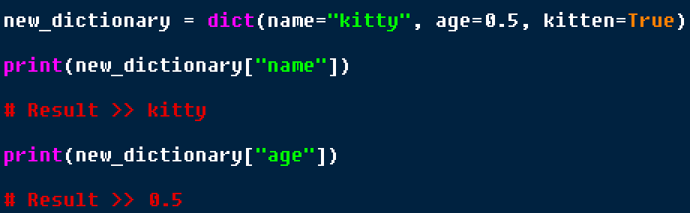
Example

Slide 24
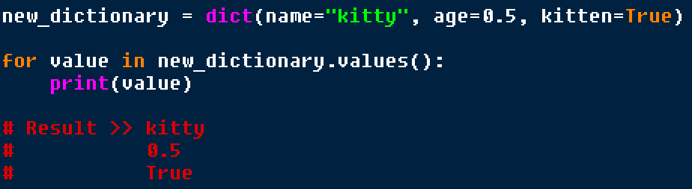
Accessing all values
We are able to use the .values() method on a dictionary in a for loop to access every value in a dictionary.

Slide 25
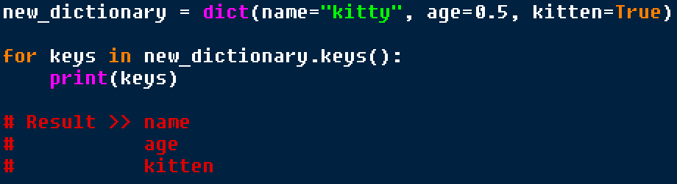
Accessing all keys
We are able to use the .keys() method on a dictionary in a for loop to access every key in a dictionary.

Slide 26
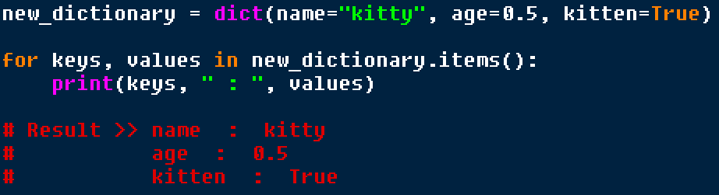
Accessing both keys & values
We are able to use the .items() method on a dictionary in a for loop to access both keys and values in a dictionary.

Slide 27
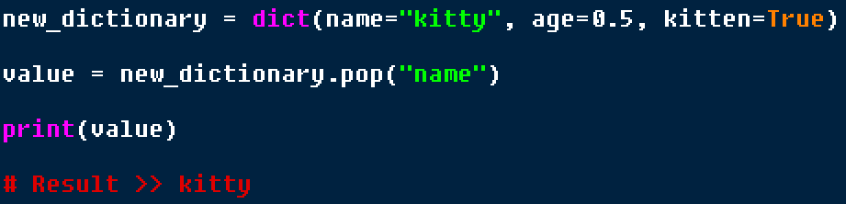
Popping from a dictionary
Similar to the list, we can use .pop() to remove a pair out of a dictionary and return the value of the pair in a variable.
Please note that using .pop() must have the key as an argument for pop to work.

Slide 28

Q & A SECTION
Please use this time to ask any questions relating to the topic, should you have any.

Slide 29

Thank you for joining!

